Slide 1
ABC Call Volume Trend Analysis
By Santhosh R

Slide 2

Project Objective
Objective
Analysis the ABC data. Calculate average call answered time.
Calculate ABC Insurance Company Manpower.
Calculate ABC Insurance Company Night Time support.

Slide 3
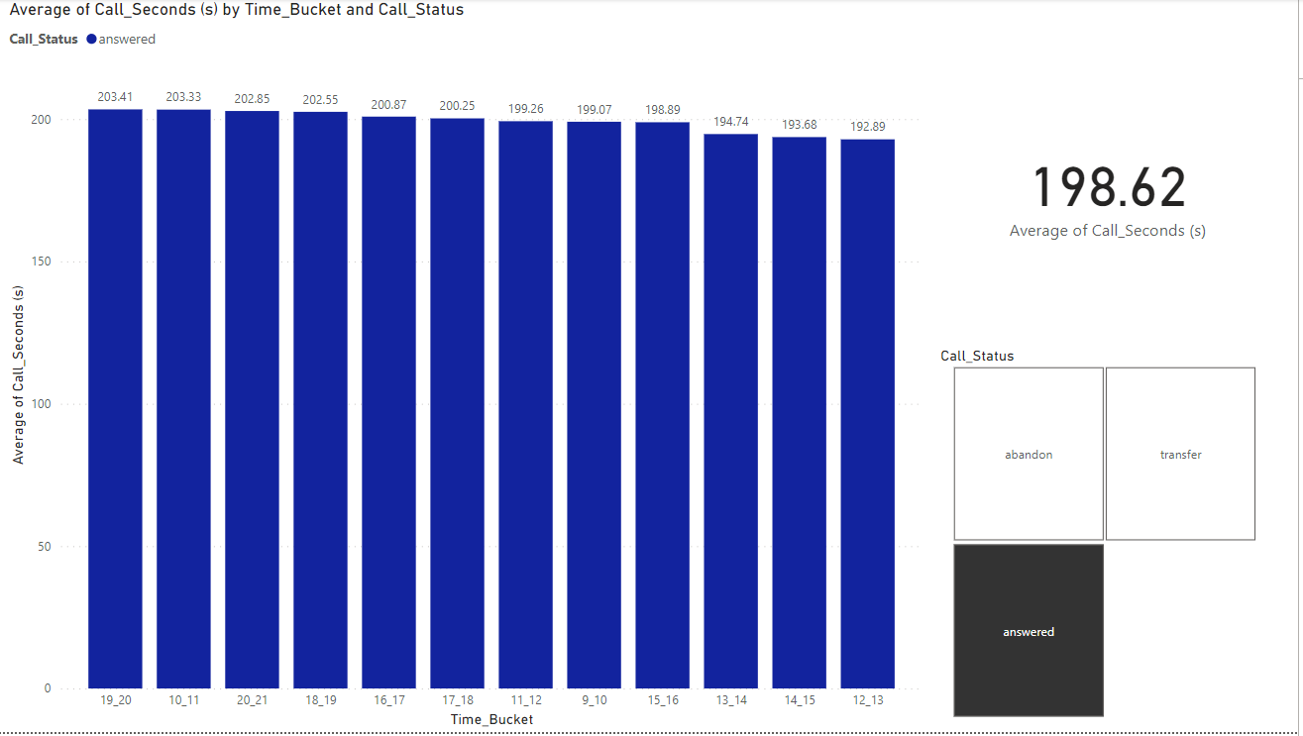
Average call time duration
The average call time duration for call answered fro agent side is 198.62 sec.
Most of the Call comes in 19_20 Time Bucket.
Here I am mention each time Bucket time average call duration time.

Slide 4
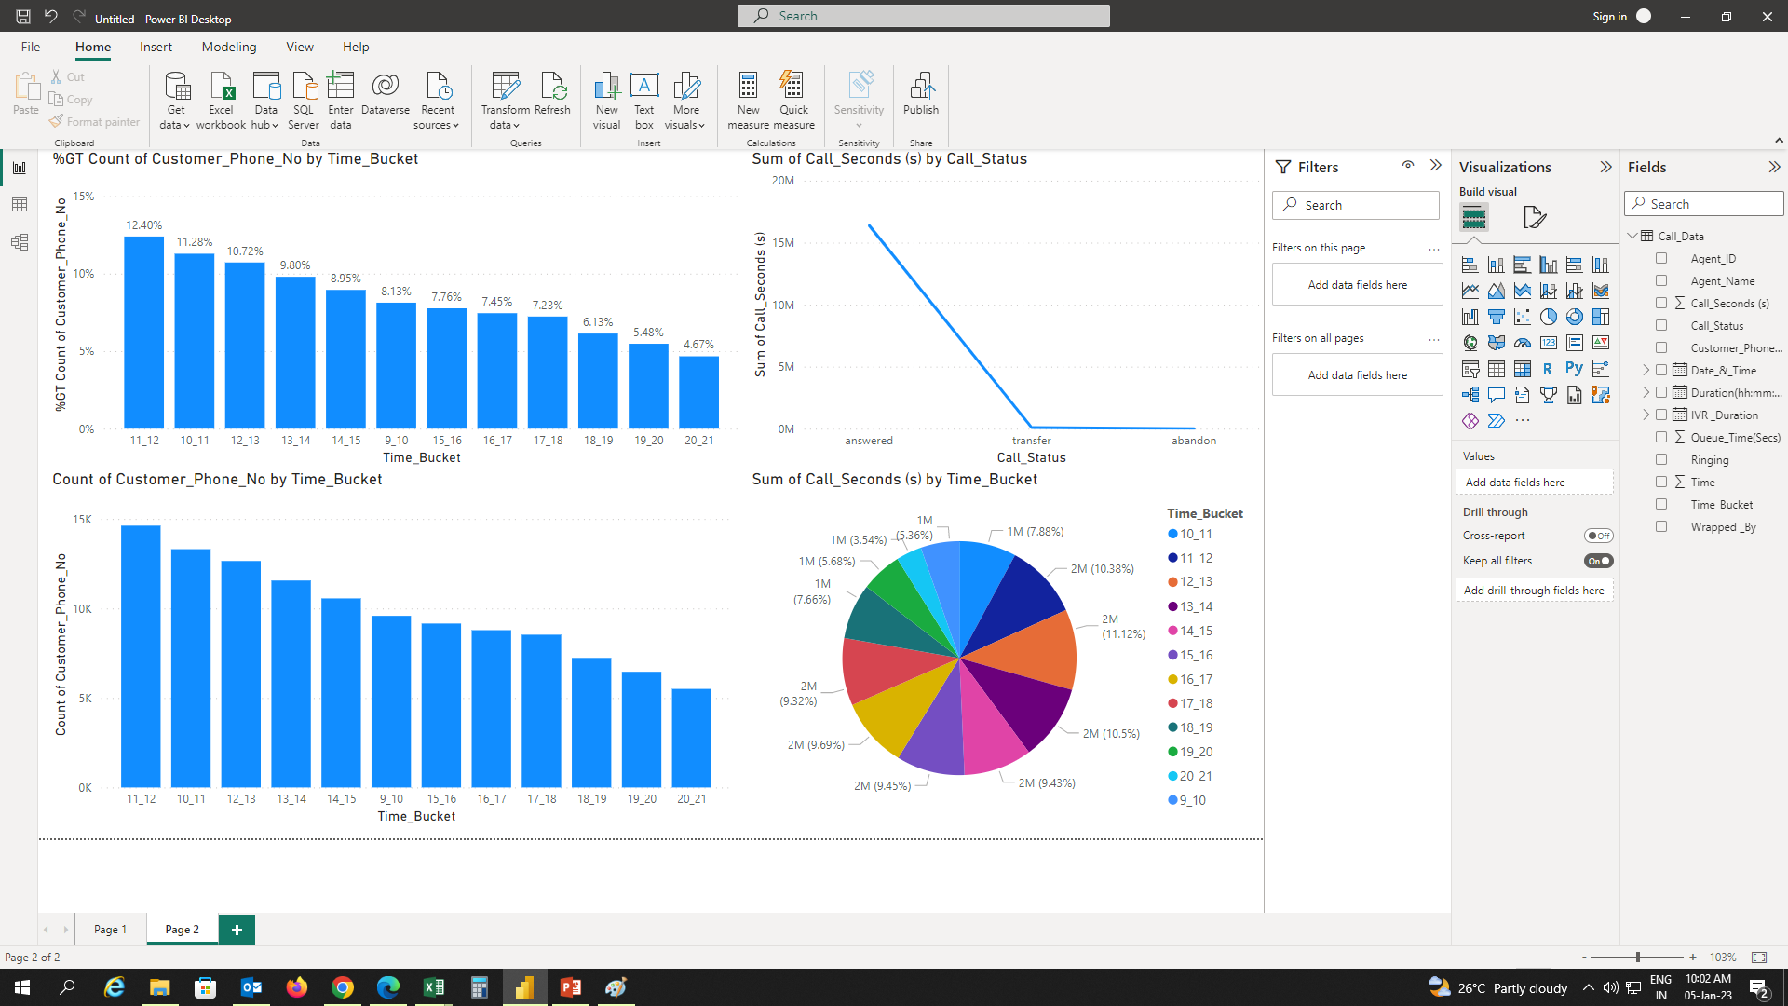
Charts/ Graphs [Number of calls v/s Time]

Slide 5

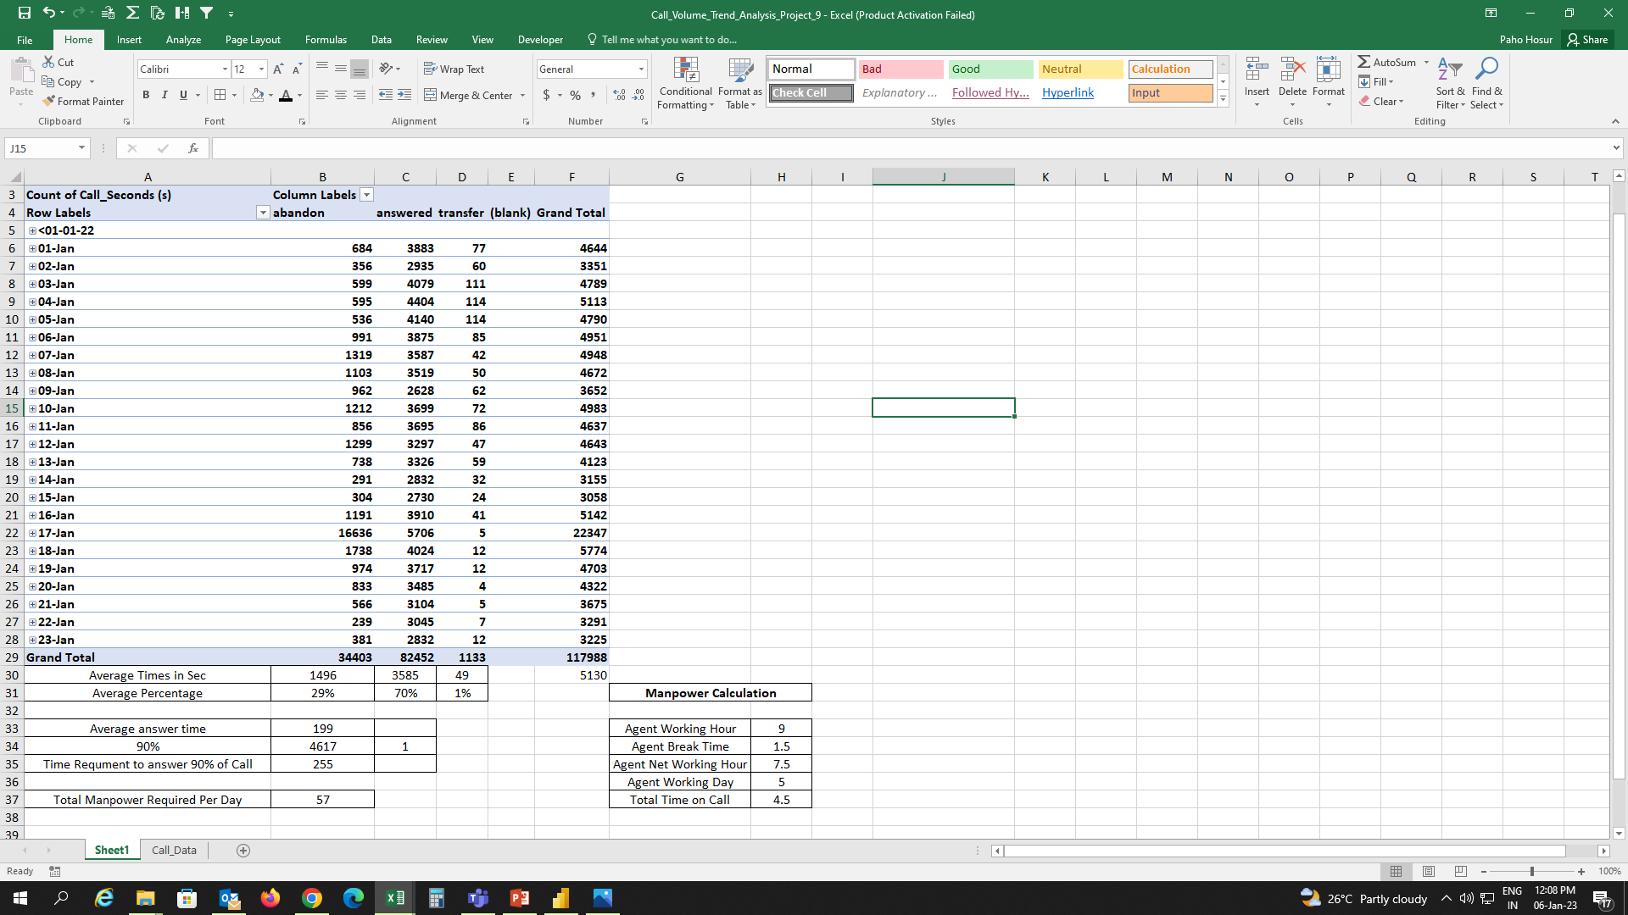
Manpower Calculation To Answered 90% Calls
As per Data 70% Calls only answered by the Agent Team member rest of the call 30% abandon and 1% transfer. I think abandon is happened due to less Manpower.
So 57 Manpower Required to Answered 90% of Calls.

Slide 6
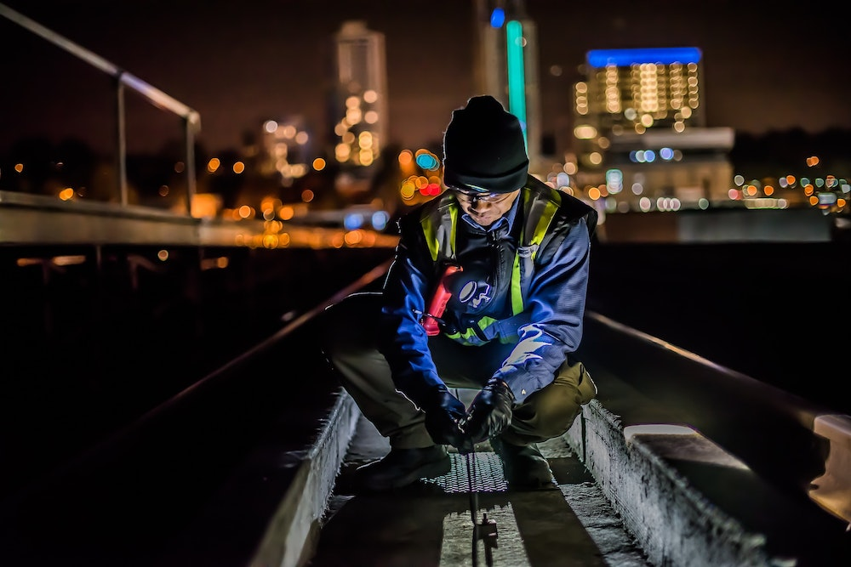
09:00 PM TO 09:00 AM Manpower Calculation
As per given Data 30% of call are received in Night Time between 09:00 pm To 09:00 am.
100% Average Call Time = 5130 Sec
Now we want to increase 30% of calls in Night Time. So Night Time = 1539 Sec
Totally 19 Manpower Required in Night Time only ( 09:00 PM TO 09:00 AM )
Total Manpower = 57 Day+19 Night = 76
Average answer time | 199
Total Call | 5130
Total Call 09:00 AM to 09:00 PM | 5130
Total Call 09:00 PM to 09:00 AM ( 30% of Calls from 09:00 AM To 09:00 PM | 1539
Night Shift Additional Hosur ( 09:00 pm To 09:00 am) | 85
Night Shift Total Manpower | 19
Total Manpower in Day ( 09:00 AM TO 09:00 PM) | 57
Total Manpower | 76

Slide 7

THANKS

